Slide 1
MGS 425 (S1S & S2S)
Management of it projects
Week 12 – April 19th

Slide 2
Agenda
Chapter 20 – Sprint Execution
Chapter 21 – Sprint Review
TopHat Assignment due by Sunday, April 25th at 11:59 pm

Slide 3
Sprint Execution
Chapter 20

Slide 4
Sprint Execution
Chapter Outline
Overview
  Timing
  Participants
  Process
Sprint Execution Planning
Flow Management
  Parallel Work and Swarming
  Which Work to Start
  How to Organize Task Work
  What Work Needs to Be Done?
  Who Does the Work?

Slide 5
Sprint Execution
Chapter Outline
Daily Scrum
Task Performance—Technical Practices
Communicating
  Task Board
  Sprint Burndown Chart
  Sprint Burnup Chart
Closing

Slide 6
Sprint Execution - Overview
Sprint execution is the work the Scrum team performs to meet the sprint goal.
This chapter focuses on the principles and techniques that guide how the Scrum team plans, manages, performs, and communicates during sprint execution.
Sprint execution is like a mini project unto itself—all of the work necessary to deliver a potentially shippable product increment is performed.

Slide 7
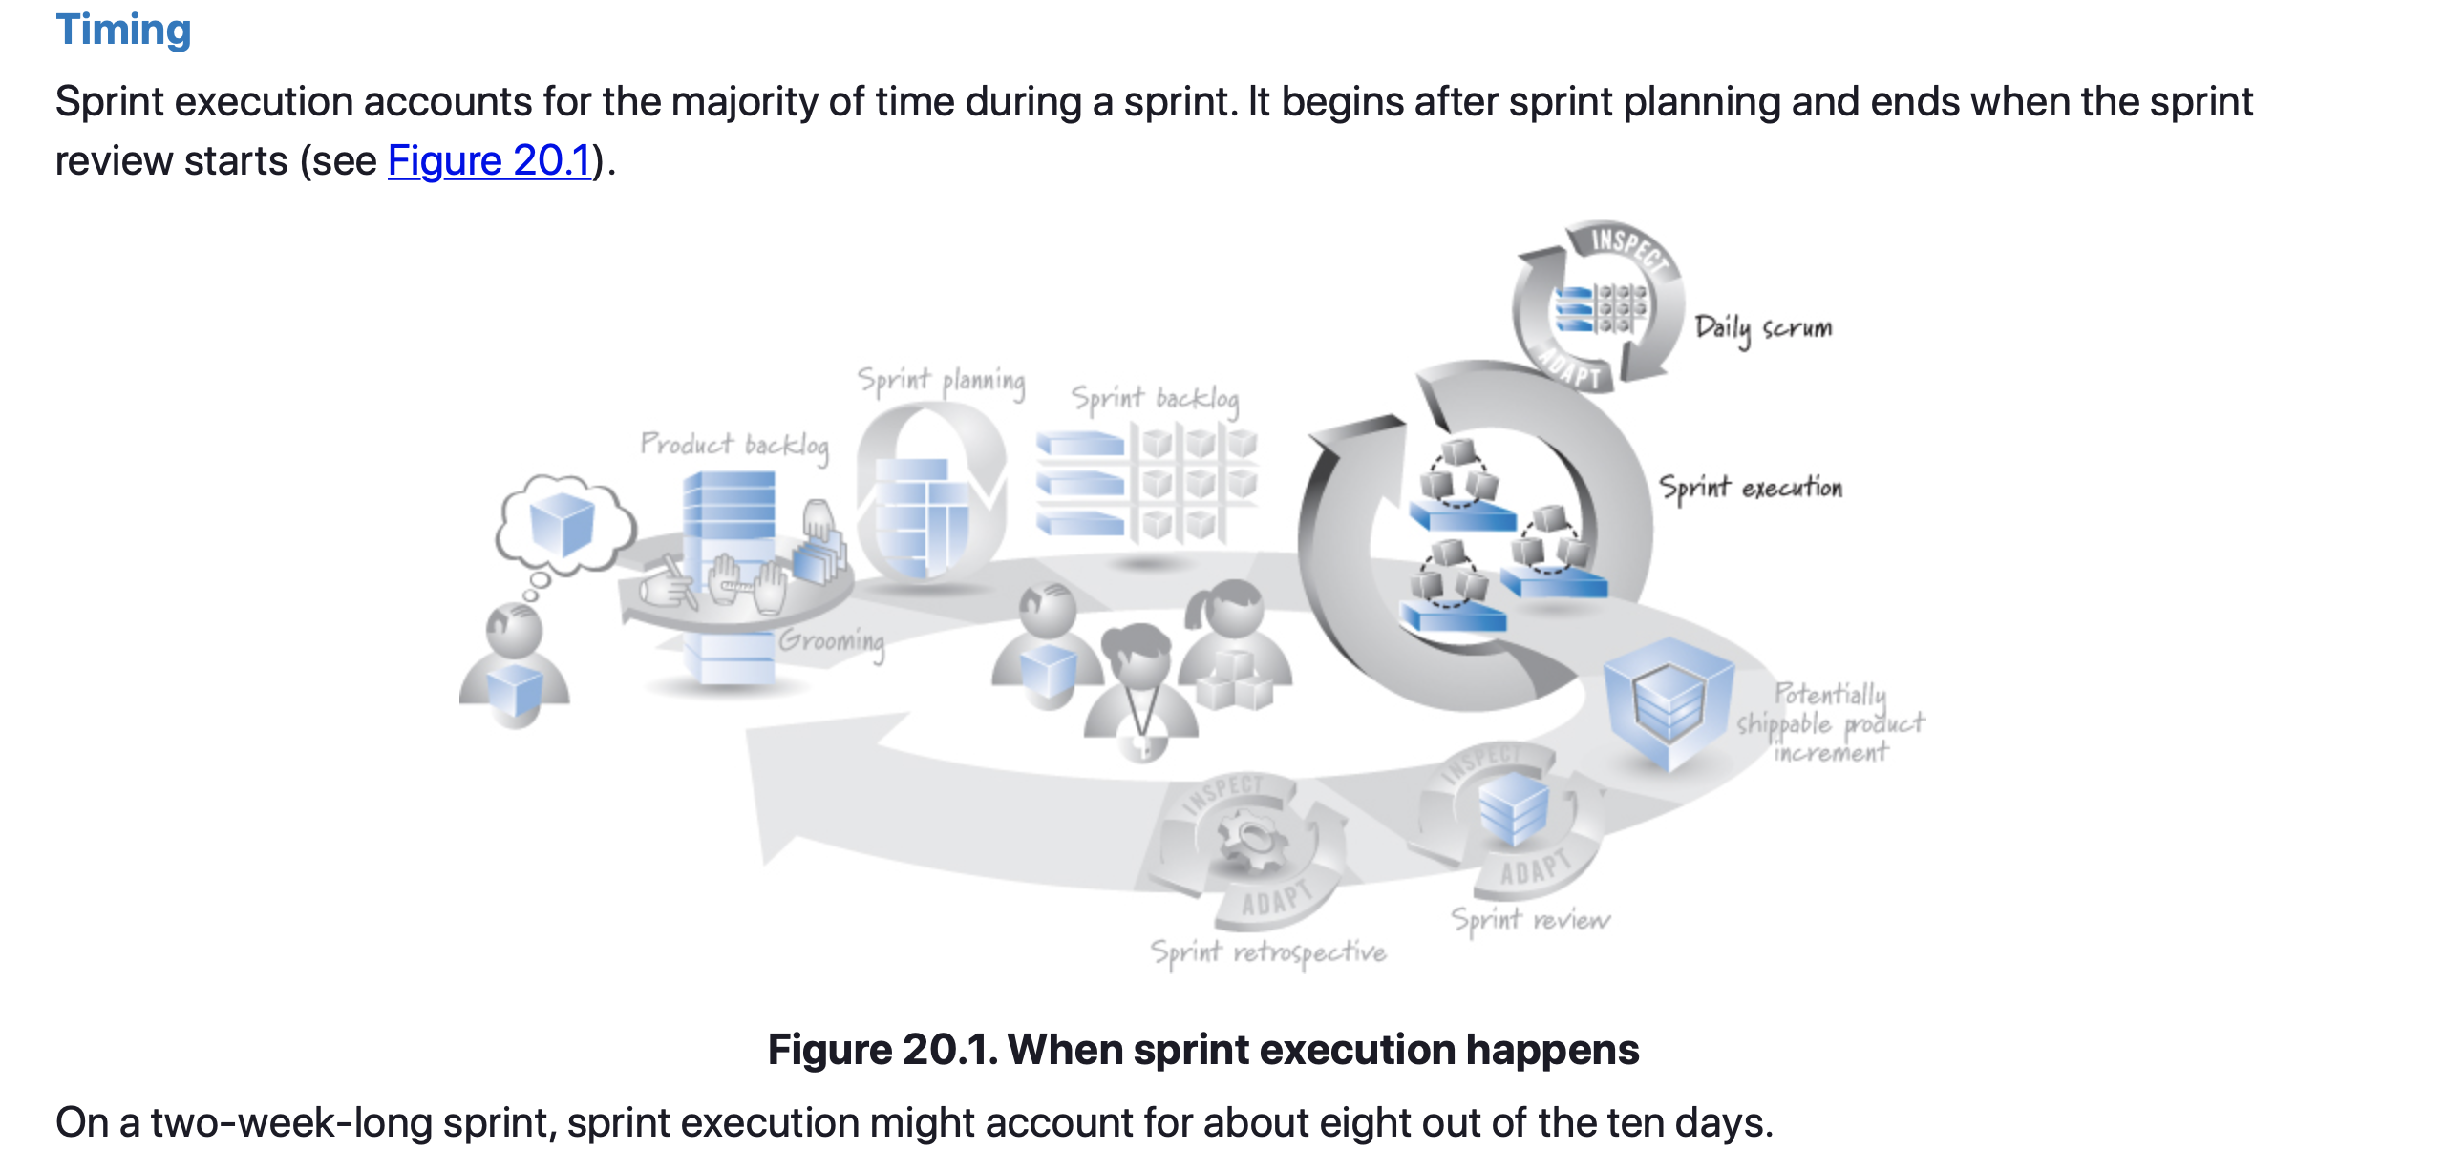
Sprint Execution – Timing

Slide 8
Sprint Execution - Participants
During sprint execution the development team members self-organize and determine the best way to meet the goal established during sprint planning.
The ScrumMaster participates as the coach, facilitator, and impediment remover, doing whatever is possible to help the team be successful.
  The ScrumMaster doesn’t assign work to the team or tell the team how to do the work. A self-organizing team figures these things out for itself.
The product owner must be available during sprint execution to:
  Answer clarifying questions.
  Review intermediate work and provide feedback to the team.
  Discuss adjustments to the sprint goal if conditions warrant.
  Verify that the acceptance criteria of product backlog items have been met.

Slide 9
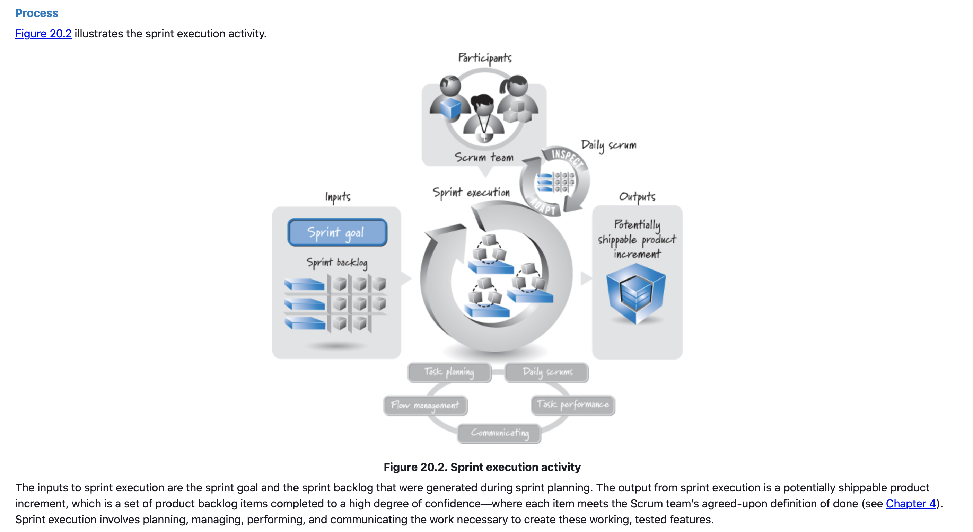
Sprint Execution – Process

Slide 10
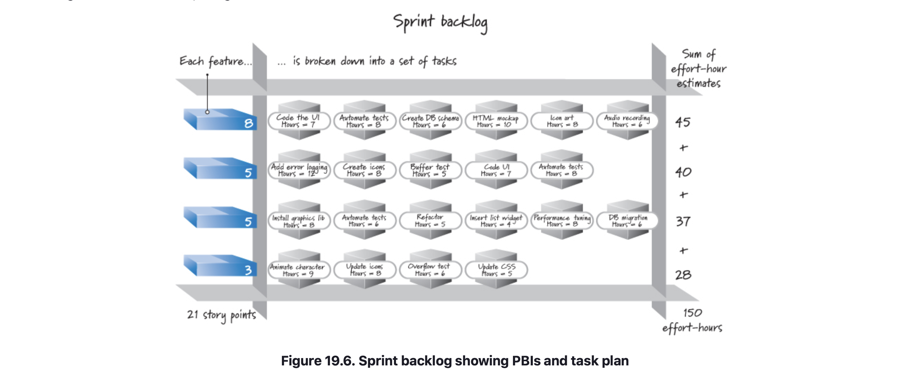
Sprint Execution – Planning
During sprint planning the team produces a plan for how to achieve the sprint goal. Most teams create a sprint backlog, which typically lists product backlog items and their associated tasks and estimated effort-hours (see Figure 19.6).

Slide 11
Sprint Execution – Flow Management
The team is responsible for managing the flow of work during sprint execution to meet the sprint goal.
It must make decisions such as how much work the team should do in parallel, when work should begin on a specific item, how the task-level work should be organized, what work needs to be done, and who should do the work.
When answering these questions, teams should discard old behaviors, such as trying to keep everyone 100% busy (the consequences of which are described in Chapter 2), believing that work must be done sequentially, and having each person focus on just her part of the solution.

Slide 12
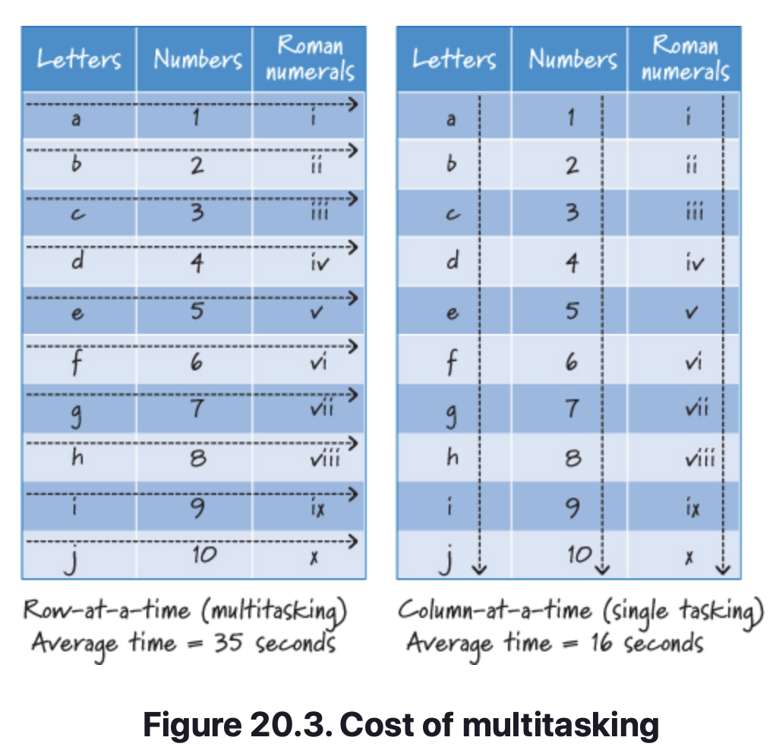
Sprint Execution – Flow Management
Parallel Work and Swarming
An important part of managing flow is determining how many product backlog items the team should work on in parallel to maximize the value delivered by the end of the sprint.
Working on too many items at once contributes to team member multitasking, which in turn increases the time required to complete individual items and likely reduces their quality.
Figure 20.3 shows a simple example that I use in my training classes to illustrate the cost of multitasking.
The goal is to complete two identical tables by writing the letters a to j, the numbers 1 to 10, and Roman numerals i to x.

Slide 13
Sprint Execution – Flow Management
Parallel Work and Swarming
One table is completed a row at a time, and the other is completed a column at a time.
The row-at-time table represents multitasking.
The column-at-a-time table represents single tasking.
The typical results shown in Figure 20.3 are that most people complete the column-at-a-time table in about half the time of the row-at-a-time table.
Also, if people make any errors, they make them when completing the row-at-a-time table.
So, even for simple multitasking the overhead can be quite high. Imagine the waste involved when multitasking on complex project work.

Slide 14
Sprint Execution – Flow Management
Parallel Work and Swarming
Just as working on too many items at the same time is wasteful, working on too few items at a time is also wasteful.
  It leads to underutilization of team member skills and capacity, resulting in less work being completed and less value being delivered.
To find the proper balance, I recommend that teams work on the number of items that leverages, but does not overburden, the T-shaped skills and available capacity of the team members.
The goal is to reduce the time required to complete individual items while maximizing the total value delivered during the sprint (typically the number of items completed during the sprint).

Slide 15
Sprint Execution – Flow Management
Parallel Work and Swarming
A term frequently used to describe this approach is swarming, where team members with available capacity gather to work on an item to finish what has already been started before moving ahead to start work on new items. Teams with a Musketeer attitude and some degree of T-shaped skills swarm.
Teams that still think in terms of individual roles wind up with some members far ahead and others who are mired in unfinished work.
A classic individual-role-focused thought is “The testers might still have ‘their’ work to finish up, but I’m finished coding this feature, so I’m off to start coding the next one.”
In a team that swarms, people would understand that it is typically better to stay focused and help get the testing done instead of running ahead to start working on new features.

Slide 16
Sprint Execution – Flow Management
What Work Needs to Be Done
What task-level work does the team perform to complete a product backlog item?
Ultimately the team decides, so product owners and managers must trust that the team members are responsible professionals who have a vested interest in doing great work.
As such, they need to empower these individuals to do the necessary work to create innovative solutions in an economically sensible way.
Product owners and company managers have influential input to what task-level work gets done. This negotiation is done as part of the collaborative nature of Scrum.
The product owner ensures that the scope of a feature and its acceptance criteria are defined, both of which provide boundaries for the task-level work.

Slide 17
Sprint Execution – Flow Management
Who does the Work
Who should work on each task? An obvious answer is the person best able to quickly and correctly get it done. What if that person is unavailable? Perhaps she is already working on another, more important task, or maybe she is out sick and the task needs to get done immediately.
There are a number of factors that can and should influence who will work on a task; it’s the collective responsibility of the team members to consider those factors and make a good choice.
When team members have T-shaped skills, several people on the team have the ability to work on each task. When some skills overlap among team members, the team can swarm people to the tasks that are inhibiting the flow of a product backlog item through sprint execution, making the team more efficient.

Slide 18
Sprint Execution – Daily Scrum
The daily scrum is a critical, daily inspect-and-adapt activity to help the team achieve faster, more flexible flow toward the solution.
The goal of the daily scrum is for people who are focused on meeting the sprint goal to get together and share the big picture of what is happening so that they can collectively understand how much to work on, which items to start working on, and how to best organize the work among the team members.
The daily scrum also helps avoid waiting. If there is an issue that is blocking flow, the team would never have to wait more than a day to discuss it.
  Imagine if the team members got together only once a week—they would deny themselves the benefits of fast feedback.
Overall the daily scrum is essential for flow management.

Slide 19
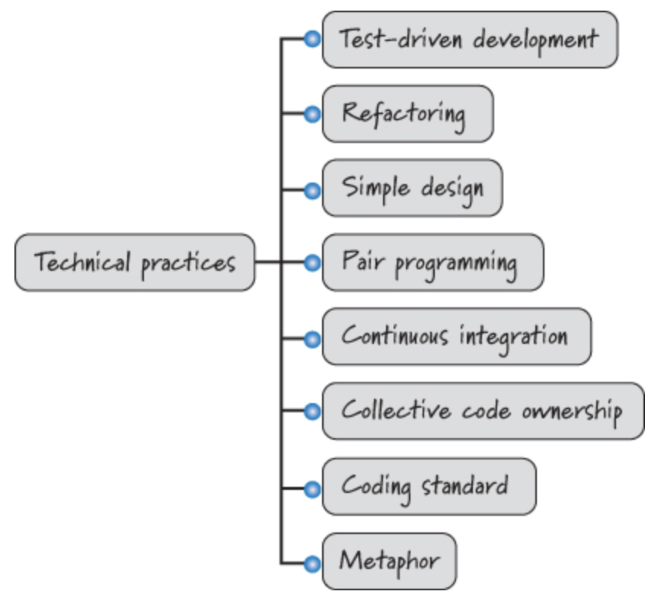
Sprint Execution – Task Performance, Technical Practices
Development team members are expected to be technically good at what they do.
However, working in short, timeboxed iterations where there is an expectation of delivering potentially shippable product increments does exert pressure on teams to get the job done with good control over technical debt.
If team members lack appropriate technical skills, they will likely fail to achieve the level of agility needed to deliver long-term, sustainable business value.
The diagram on the right highlights some of the key technical practices that all team members should exhibit to some extent.
See: https://www.altexsoft.com/blog/business/extreme-programming-values-principles-and-practices/

Slide 20
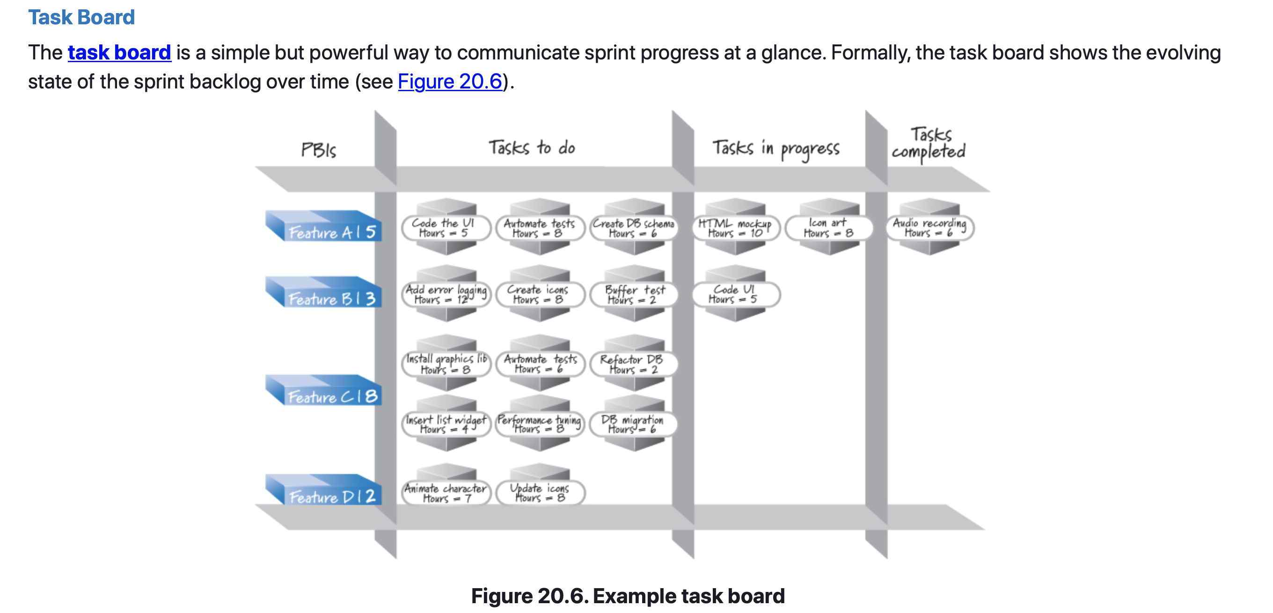
Sprint Execution – Communicating
Task Board
One of the benefits of working in short timeboxes with small teams is that you don’t need complex charts and reports to communicate progress! Although any highly visible way of communicating progress can be used, most teams use a combination of a task board and a burndown and/or burnup chart as their principal information radiator.
Notes:
information radiator - A visual display that presents up-to-date, sufficiently detailed, and important information to passersby in an easy, self-interpretable format.

Slide 21
Sprint Execution – Communicating
Task Board
Another example is a Kanban board, which can be done using sticky notes. There are also applications that will track this information electronically.

Slide 22
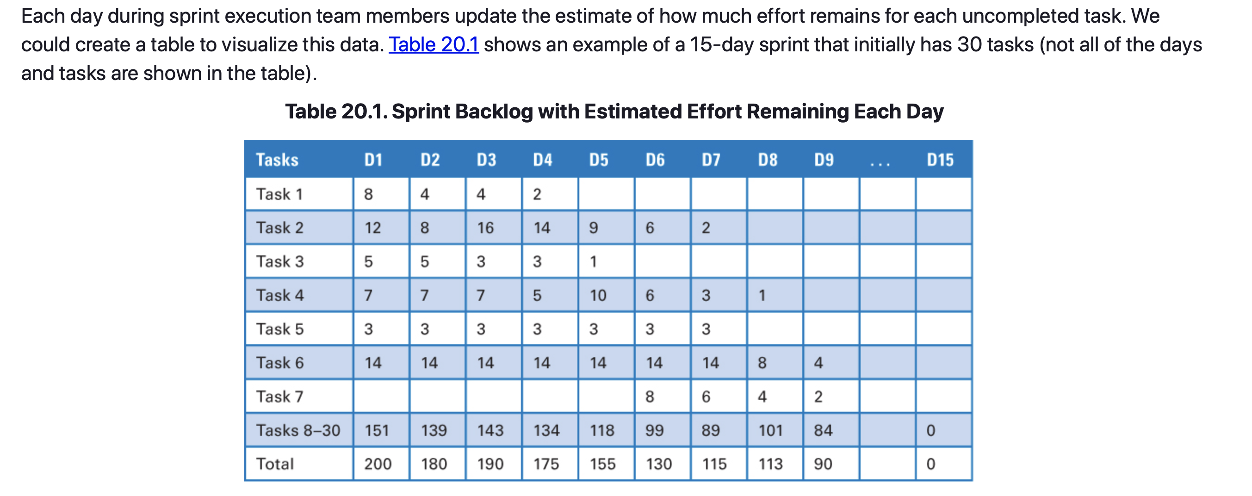
Sprint Execution – Communicating
Sprint Burndown Charts

Slide 23
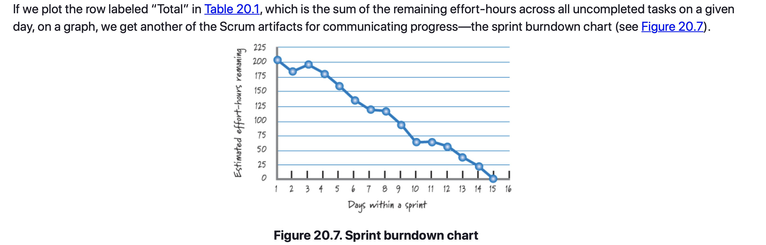
Sprint Execution – Communicating
Sprint Burndown Charts

Slide 24
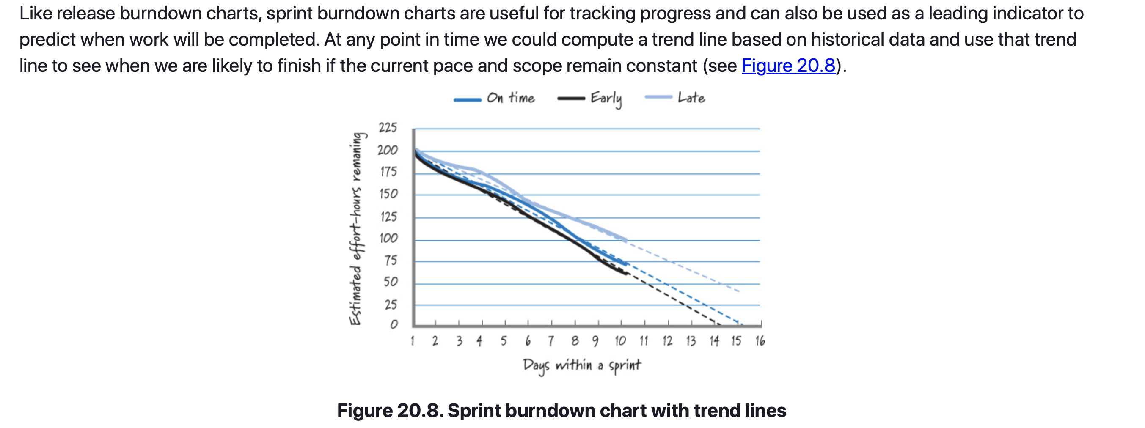
Sprint Execution – Communicating
Sprint Burndown Charts

Slide 25
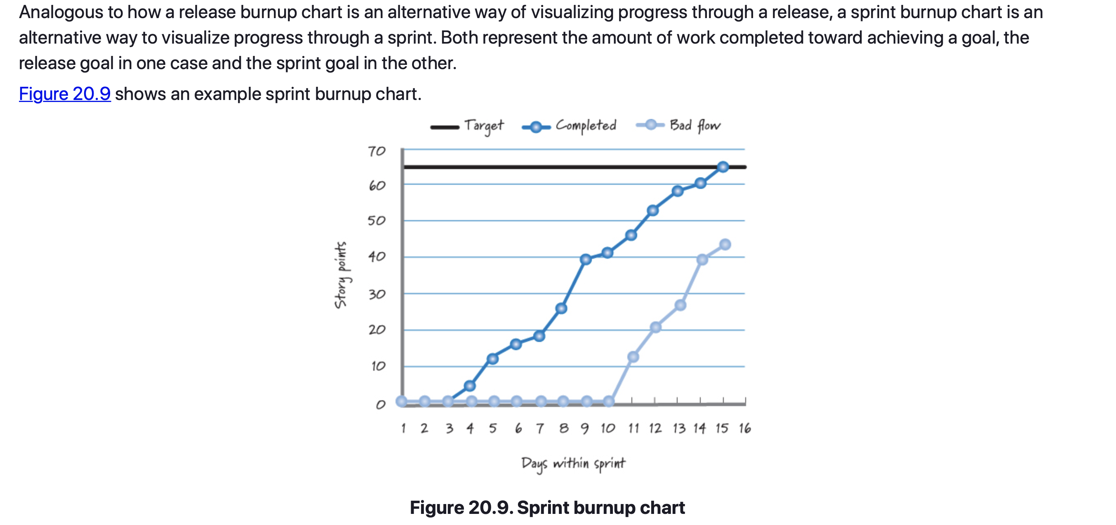
Sprint Execution – Communicating
Sprint Burnup Charts

Slide 26
Sprint Execution – Closing
Discussed sprint execution, which accounts for the majority of the time during a sprint.
Emphasized that sprint execution is performed opportunistically, leveraging the skills of the team, feedback from work already completed, and the evolving, unpredictable circumstances of the sprint.
Discussed the value of the daily scrum meeting as an important activity in flow management.
Discussed the importance of good technical practices in achieving high levels of agility.
Discussed the various ways that the Scrum team can visually communicate sprint progress through the task board, sprint burndown chart, and sprint burnup chart.

Slide 27
Sprint Review
Chapter 21

Slide 28
Sprint Review
Chapter Outline
Overview
Participants
Prework
  Determine Whom to Invite
  Schedule the Activity
  Confirm That the Sprint Work Is Done
  Prepare for the Demonstration
  Determine Who Does What

Slide 29
Sprint Review
Chapter Outline
Approach
  Summarize
  Demonstrate
  Discuss
  Adapt
Sprint Review Issues
  Sign-offs
  Sporadic Attendance
  Large Development Efforts
Closing

Slide 30
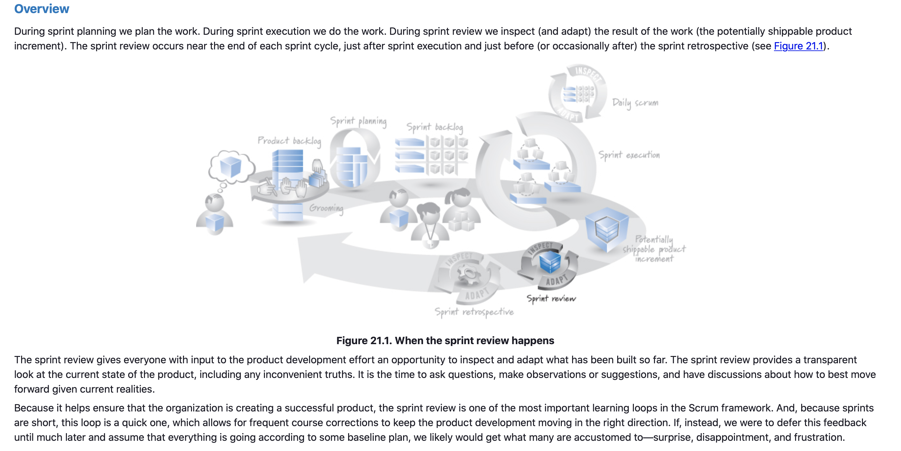
Sprint Review – Overview

Slide 31
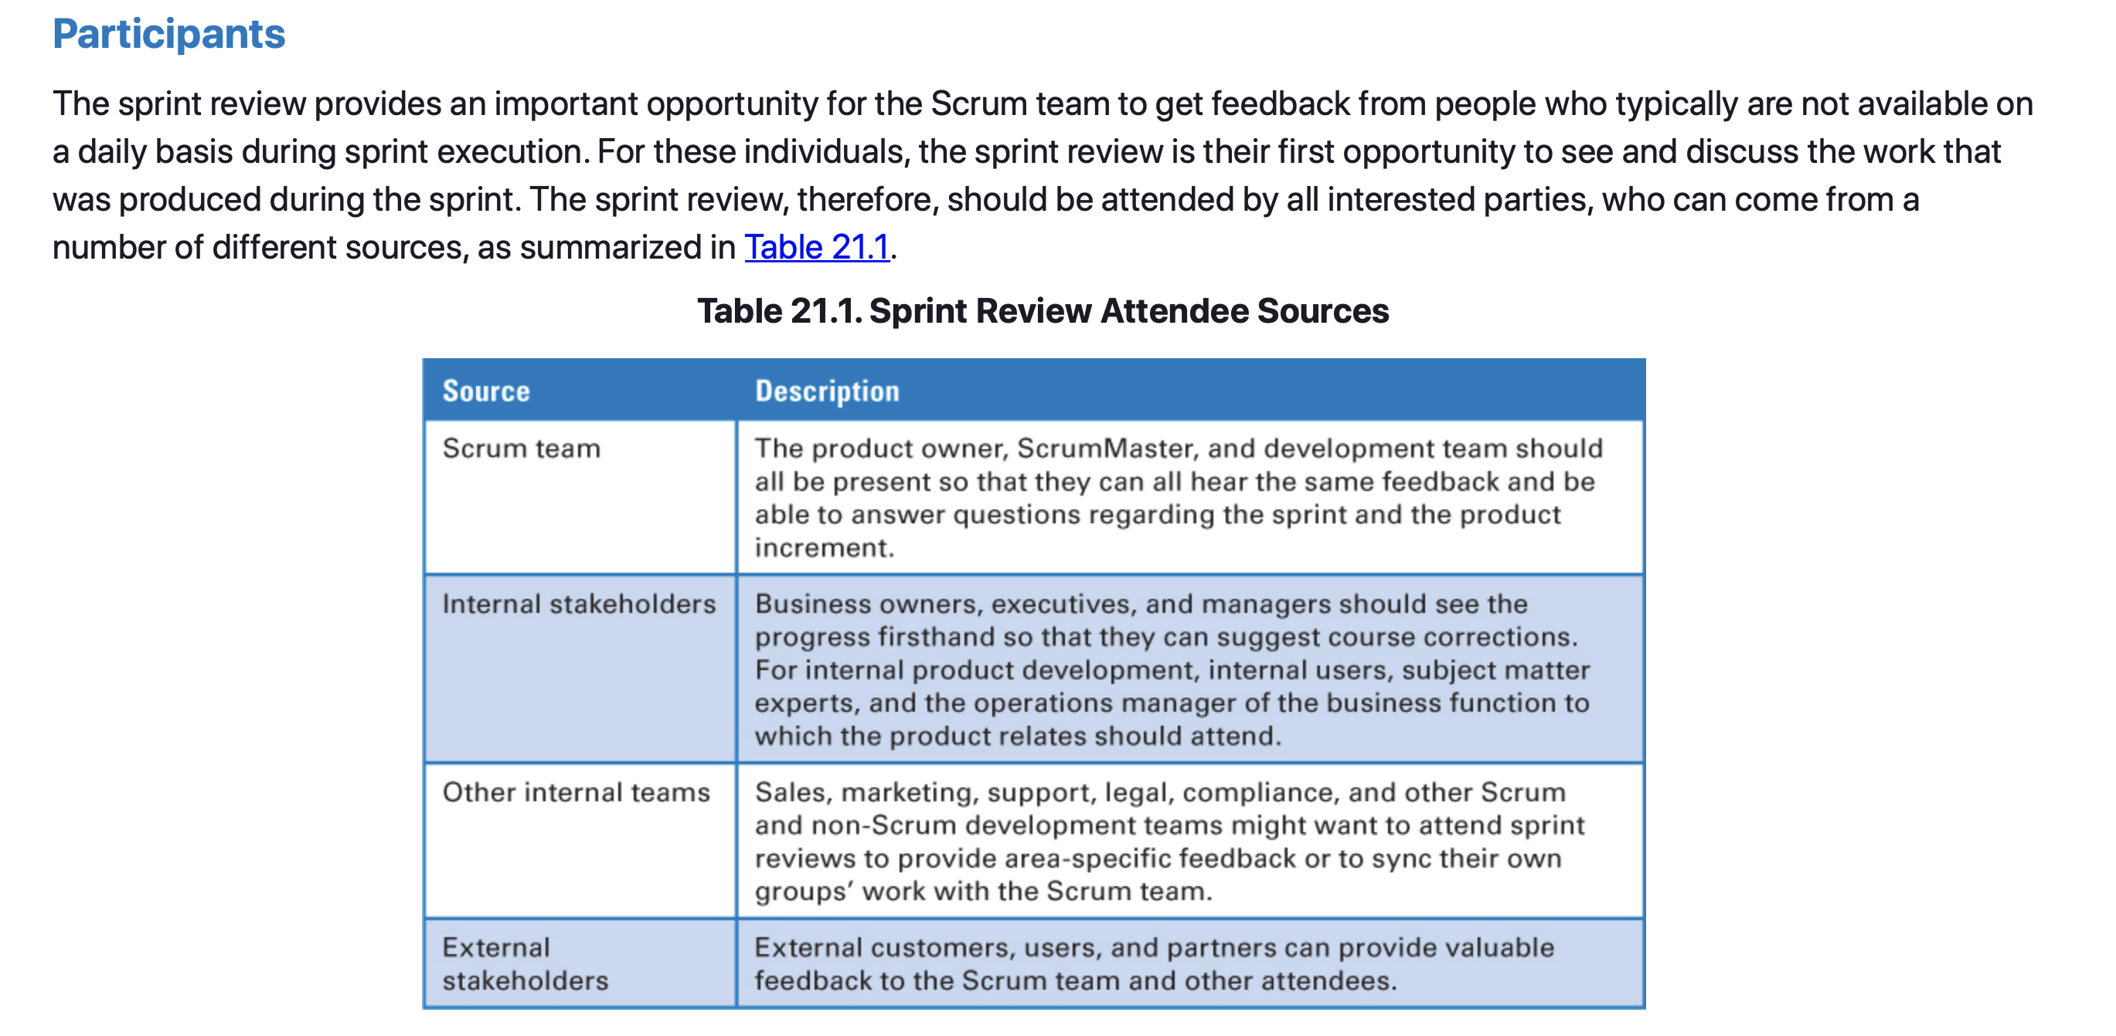
Sprint Review – Participants

Slide 32
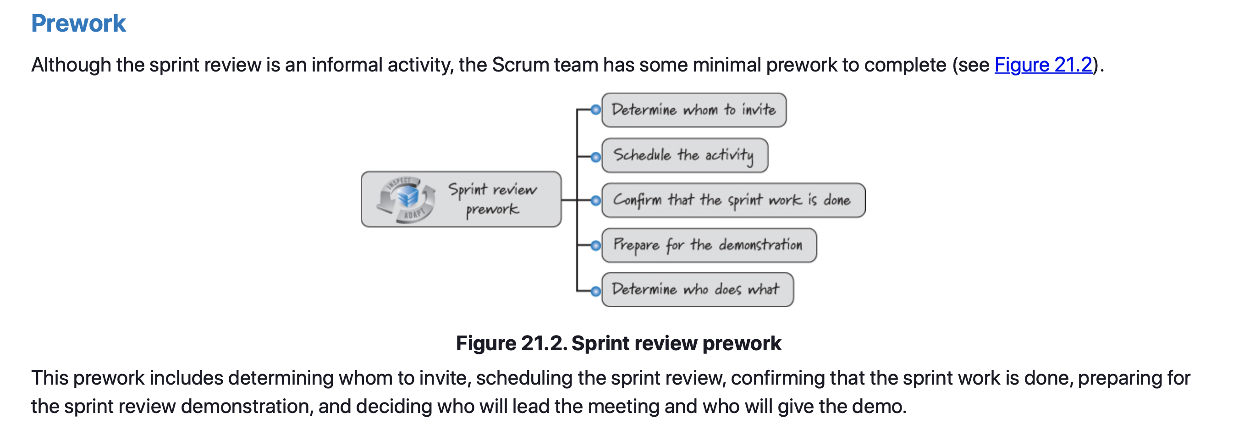
Sprint Review – Prework

Slide 33
Sprint Review – Prework
Determine Whom to Invite
The goal is to get the right set of people into the room to extract the highest possible value.
  Unless there is a good reason to not invite someone or some group, cast a broad net and let people vote with their feet—if they’re interested, they’ll walk to the room and attend the meeting.
Occasionally, the team might need to constrain attendance.
  For instance, the team might need to focus on a certain person or group whose input is essential to reviewing this sprint’s work.
If you suspect these situations might arise, identify a core group that should be invited to every review and then issue a separate invitation to certain groups or clients on a sprint-by-sprint basis.

Slide 34
Sprint Review – Prework
Schedule the Sprint Review Activity
The sprint review needs to be scheduled (when, where, and how long).
Of the four required, recurring Scrum activities (sprint planning, daily scrum, sprint review, and sprint retrospective), the sprint review is the hardest to schedule because it includes many people who are outside of the Scrum team.
Sprint reviews vary in duration depending on several factors, including sprint length, team size, and whether multiple teams are participating in the same review.
Typically, however, the sprint review does not exceed a four-hour timebox. Many teams have found the one-hour-per-sprint-week rule helpful.

Slide 35
Sprint Review – Prework
Confirm That the Sprint Work Is Done
At the sprint review, the team is allowed to present only completed work—work that meets the agreed-upon definition of done.
Ultimately it is the product owner’s responsibility to determine if the work is done or not.
  As mentioned in Chapter 9, the product owner should be performing just-in-time reviews of product backlog items as they become available during sprint execution. This way, by the time the sprint review happens, the team knows which items are complete.

Slide 36
Sprint Review – Prework
Confirm That the Sprint Work Is Done
In practice, not everyone agrees that the product owner should review the work before the sprint review.
  They believe that if the product owner is allowed to review the work during the sprint, he might request changes that go beyond clarification—goal-altering changes that will disrupt sprint execution.
  This is a potential risk, but the benefits of early product owner reviews (fast feedback) far outweigh any downside. Furthermore, if the product owner sees the team’s work for the first time at the sprint review meeting, he has seen it too late.
Beyond this, however, a product owner who rejects or questions work during the sprint review might not appear to be on the same page as the rest of the Scrum team.

Slide 37
Sprint Review – Prework
Prepare for the Demonstration
Because all of the work the team presents at the sprint review is done (potentially shippable), it shouldn’t take much preparatory work to demonstrate it.
  The goal is to provide transparency for inspecting and adapting the product, not to put on a glitzy Hollywood production or showcase to create excitement.
The sprint review is supposed to be an informal meeting with low ceremony and high value, where working software should be shown (not a slide deck).
Many teams have a rule of not spending more than 30 minutes to an hour per week of sprint duration to prepare for the sprint review.

Slide 38
Sprint Review – Determine Who Does What
Determine Who Does What
Prior to the sprint review, the team needs to decide who on the Scrum team is going to facilitate the review and who will demonstrate the completed work.
Typically the ScrumMaster facilitates, but the product owner might kick things off by welcoming members of the stakeholder community and providing a synopsis of the sprint results.
The Scrum team can make the determination with a goal of maximizing the benefit of the review activity.

Slide 39
Sprint Review – Determine Who Does What
Process
The inputs to the sprint review are the sprint backlog and/or sprint goal and the potentially shippable product increment that the team actually produced.
The outputs of the sprint review are a groomed product backlog and an updated release plan.
A common approach to conducting the sprint review includes:
  Providing a summary or synopsis of what has and has not been accomplished with regard to the sprint goal.
  Demonstrating the potentially shippable product increment.
  Discussing the current state of the product.
  Adapting the future product direction.

Slide 40
Sprint Review – Determine Who Does What
Summarize the Results
If the results don’t align with the Sprint goal, the Scrum team provides an explanation.
It is important that the sprint review be a blame-free environment. If the goal wasn’t met, everyone participating should refrain from trying to assess blame.
The purpose of the review is to describe what was accomplished and then to use the information to determine the best course of action for moving forward.

Slide 41
Sprint Review – Determine Who Does What
Demonstrate
The sprint review is frequently mislabeled the “sprint demo” or just “the demo.”
Although a demonstration is quite helpful in the sprint review, the demo is not the aim of the sprint review.
The most important aspect of the sprint review is in-depth conversation and collaboration among the participants to enable productive adaptations to surface and be exploited.
The demonstration of what actually got built is simply a very efficient way to energize that conversation around something concrete.
Nothing provides focus to the conversation like being able to actually see how something works.

Slide 42
Sprint Review – Determine Who Does What
Demonstrate
As determined in the prework, one or more Scrum team members will demonstrate all relevant aspects of the product increment that was built during the sprint.
What if there is nothing to demo?
  If the team didn’t get anything done and there is truly nothing to show, the sprint review will likely focus on why nothing got done and how the future work will be affected by the lack of progress during this sprint.
  Suppose, for instance, that the team did only architectural development work this sprint (built “glue code”). In that case, the development team might argue that demonstrating glue code doesn’t make any sense or isn’t practical.
  For the team to work exclusively on “glue code,” it would have needed to convince the product owner to allow only technical product backlog items into the sprint.
  Therefore, the product owner would vouch for the need to spend resources on this activity.

Slide 43
Sprint Review – Determine Who Does What
Discuss
Demonstrating the product increment becomes the focal point for having an in-depth conversation.
Observation, comments, and reasonable discussion regarding the product and direction are strongly encouraged among the participants.
The sprint review, however, is not the place for deep problem solving; that type of work should be deferred to another meeting.
Vigorous discussion allows participants who aren’t on the Scrum team to ask questions, understand the current state of the product, and help guide its direction.
At the same time, the Scrum team members gain a deeper appreciation for the business and marketing side of their product by getting feedback on the convergence of the product toward delighted customers or users.

Slide 44
Sprint Review – Determine Who Does What
Adapt
Through demonstration and discussion, the team is able to ask and answer questions, including the following:
  Do the stakeholders like what they see?
  Do they want to see changes?
  Is what we’re building still a good idea in the marketplace or to our internal customers?
  Are we missing an important feature?
  Are we overdeveloping/investing in a feature where we don’t have to?
Asking and answering these questions provides input on how to adapt the product backlog and release plans.
The sprint review gives us an opportunity to identify ways to adapt, to respond to change, when it is still affordable to do so—at the end of every single sprint.

Slide 45
Sprint Review – Sprint Review Issues
Common issues encountered during Sprint Review
Sprint reviews, however, are not without issues.
Common issues with many organizations using Scrum, include those related to sign-offs, lack of attendance, and large projects.

Slide 46
Sprint Review – Sprint Review Issues
Sign-offs
Sign-offs can be problematic to coordinate in sprint reviews.
  Before the sprint review even begins, the product owner must review the work to determine if it is done (meets the agreed-upon definition of done).
  The sprint review, therefore, should not be a formal approval or sign-off event; instead, the product backlog items should have already been “approved” by the product owner before the sprint review starts.
Let’s say, however, that during the sprint review a senior-level stakeholder disagrees—he believes the product backlog item is not done.
  While that feedback is valuable, if the product owner declared the original work done, it is done. The product owner has to be the empowered central point of product leadership.
  For this to be true, the product owner must be in a position to definitively approve or reject work and can’t have that authority usurped by a sprint review participant—no matter how senior.
Notes:
The product owner should NOT ignore comments about a feature that doesn’t meet stakeholder expectations. When this occurs, the proper course of action is to schedule a change to the feature by creating a new product backlog item to reflect the desired behavior requested by the senior stakeholder and to insert that item into the product backlog to be worked on in a future sprint. The product owner should also investigate to determine why he disconnected from the stakeholders regarding this story and make adjustments to prevent future misunderstandings.

Slide 47
Sprint Review – Sprint Review Issues
Sporadic Attendance
The sprint review needs to be viewed as a critical inspect-and-adapt activity, one that is worth people’s time to attend. Still, some organizations suffer from sporadic attendance.
Common causes (e.g. excuses) for sporadic attendance include:
  Stakeholders have so much on their plates that other “higher-priority” commitments prevent them from attending sprint reviews.
  People not believing that the Scrum team can produce anything worth reviewing in a few weeks’ time.

Slide 48
Sprint Review – Sprint Review Issues
Large Development Efforts
If you have a larger development effort with multiple Scrum teams, it might make sense to consider doing a joint sprint review.
  This is simply a review that includes the work completed by multiple highly interrelated teams.
The benefits to this approach include:
  First, the stakeholders have to attend only one sprint review instead of several.
  Second, if the work was supposed to be integrated, it would make sense for the review to focus on the integrated work, not a collection of stand-alone increments. To achieve this goal, all teams need to make sure their definitions of done include integration testing, as they probably should anyway.
The downside to holding a joint sprint review meeting with more than one team is that it will probably take a bit longer and might require a larger room than any one team would have needed.

Slide 49
Sprint Review – Closing
Emphasized the purpose of the sprint review as a critical feedback loop during Scrum development.
  How it involves a diverse set of participants, whose goal is to inspect and adapt the current product.
  During the sprint review the Scrum team provides a synopsis of what took place and what was accomplished during the sprint.
  It also provides a demonstration of the product increment produced during the sprint.
  A vigorous discussion among the participants takes place; questions, observations, and suggestions are highly encouraged.
  Based on this discussion, the product backlog will be groomed and the release plan updated.

Slide 50
Sprint Review
Sources
Unless otherwise noted, all material in these slides were used from the textbook for this course:
Rubin, Kenneth S., Essential Scrum: A Practical Guide to the Most
Popular Agile Process, 1st Edition. Addison-Wesley Professional; 1st
edition (August 5, 2012). ISBN-13: 978-0137043293.

